Slide 1

Project 3 - The Most Valued Data Science Skills
Kossi Akplaka, Carol Campbell, Saloua Daouki,
and Souleymane Doumbia

Slide 2

Using data to answer the question… “Which are the most valued data science skills?”
Our Methodology
Collaborative tools
Created dedicated GitHub repository for all code
Slack
Quick messaging; scheduling meetups
Zoom
Held several meetings to discuss progress
Share code, real time revisions
Use R Studio to clean and visualize our data
Tidyverse, stringr and gridExtra libraries of choice
Search web for suitable data set
Kaggle.com
“Data Analyst Skill Analysis” by Luke Barousse

Slide 3

Tidying the data
Steps we took…
Study raw data
Determine what we need for analysis
Plan analysis
Code
Test
Repeat steps 4 & 5
7. Present findings

Slide 4


The beginning:
Data Science
Our dataset that contained 43 columns and 15 variables – too many for our analysis, so we used various methods to clean the data
Data
Engineer
Filter data set into 3 separate careers…
use grepl function to create new titles based on description
Data
Scientist
Data
Analyst
Notes:
The first step was to g

Slide 5
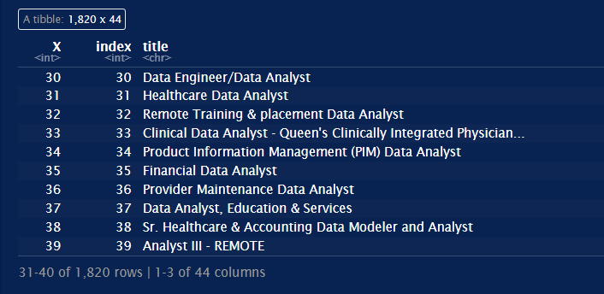
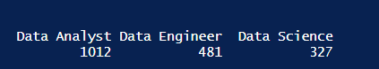
```{r} skills <- df %>% mutate(new_title = case_when( grepl("ETL|pipeline|warehouse|architect", description, ignore.case = TRUE) ~ "Data Engineer", grepl("machine learning | modeling|A/B testing", description, ignore.case = TRUE) ~ "Data Science", TRUE ~ "Data Analyst" )) tibble (skills) ```
Getting 3 separate careers

Slide 6
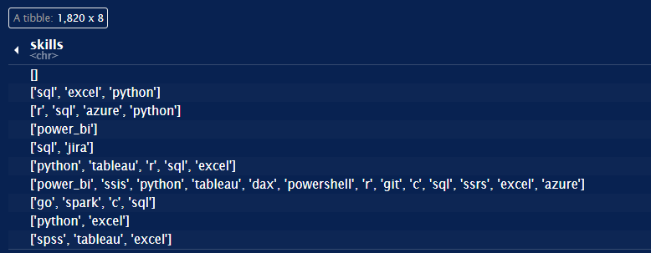
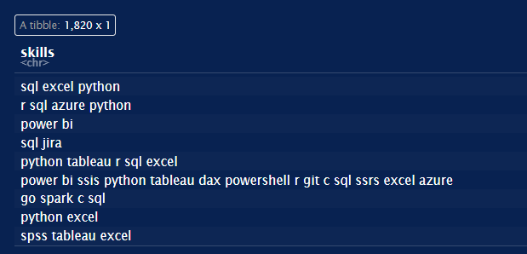

Tidying before...
and after…

Slide 7
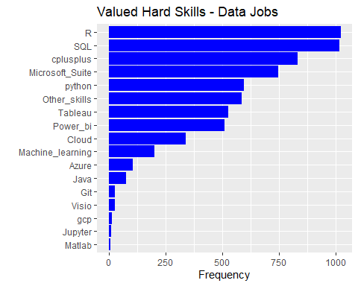
Hard skills for all Data Jobs
```{r hard skill plot}
ggplot(hardskills,aes(x=reorder(skill, freq), y=freq)) + geom_bar(stat='identity',fill="blue") + xlab('') + ylab('Frequency') + labs(title='Valued Hard Skills - Data Jobs') + coord_flip()
```
Notes:
There are a number of technological and data visualization skills that employers consider essential for data scientist candidates. Also known as "hard kills", these requirements include competence in the latest software and statistical analysis tools, strong mathematical, quantitative and analytical skills. Here, our next task was filter and group by like software skills in preparation for analysis.

Slide 8
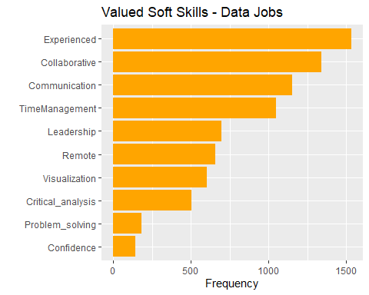
Soft skills for all Data Jobs
ggplot(softskills,aes(x=reorder(skill, freq), y=freq)) + geom_bar(stat='identity',fill="orange") + xlab('') + ylab('Frequency') + labs(title='Valued Soft Skills - Data Jobs') + coord_flip()
Notes:
While "hard skills" are important to prospective employers, strong "soft skills" are also necessary for optimal career performance. Also known as "transferable skills", soft skills include the ability to effectively communicate across and within their respective teams, with vendors and other stakeholders. Leadership, time management and problem solving are other soft skills that are often sought after. Lastly, one must also be able to present findings in non-technical terms, easily understood by a universal audience.

Slide 9
CONCLUSION FOR ALL DATA JOBS
Based on our analysis, we concluded that the top 5 valued hard skills for ALL Data Jobs
R
SQL
C++
Microsoft Suite
Python
Similarly, the top 5 valued soft skills are:
Experience
Collaboration
Communication
Time management
Leadership

Slide 10
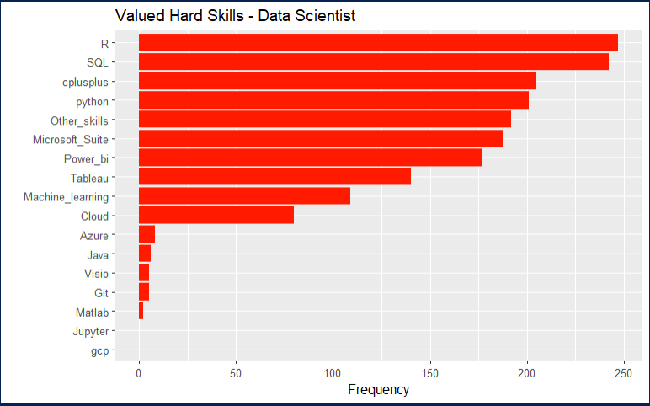
Hard skills for Data Scientist
```{r plotting the hard skills for data science}
ggplot(hardskills_science,aes(x=reorder(skill, freq), y=freq)) + geom_bar(stat='identity',fill="red") + xlab('') + ylab('Frequency') + labs(title='Valued Hard Skills - Data Scientist') + coord_flip()
```

Slide 11
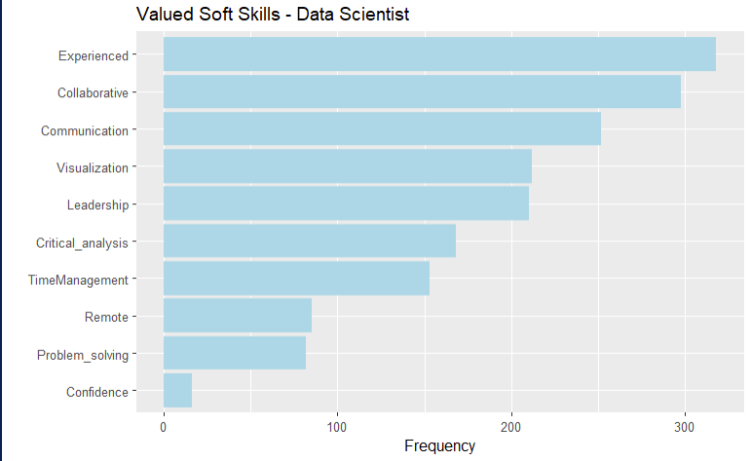
Soft skills for Data Scientist
```{r plotting the soft skills for data science}
ggplot(softskills_science,aes(x=reorder(skill, freq), y=freq)) + geom_bar(stat='identity',fill="lightblue") + xlab('') + ylab('Frequency') + labs(title='Valued Soft Skills - Data Scientist ‘) +
coord_flip()
```

Slide 12
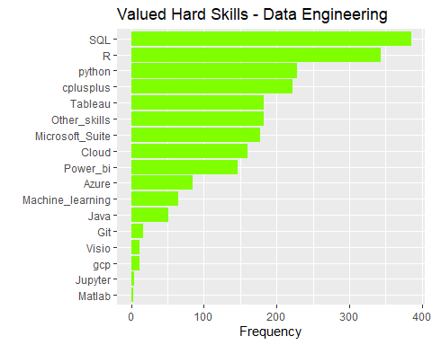
Hard Skills Data Engineering Jobs
```{r plotting the hard skills for data engineer}
ggplot(hardskills_engineer,aes(x=reorder(skill, freq), y=freq)) + geom_bar(stat='identity',fill="chartreuse1") + xlab('') + ylab('Frequency') + labs(title='Valued Hard Skills - Data Engineering') + coord_flip()
```

Slide 13
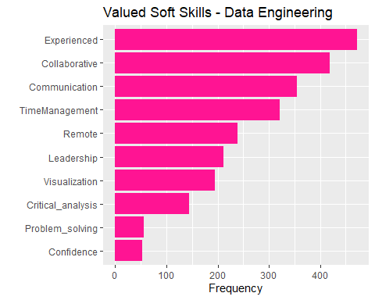
Soft Skills Data Engineering Jobs
```{r plotting the soft skills for data engineer}
ggplot(softskills_engineer,aes(x=reorder(skill, freq), y=freq)) + geom_bar(stat='identity',fill="deeppink") + xlab('') + ylab('Frequency') + labs(title='Valued Soft Skills - Data Engineering') + coord_flip()
```

Slide 14
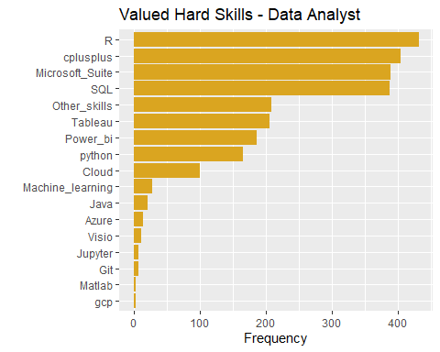
Hard Skills Data Analyst Jobs
```{r plotting the hard skills for data analyst}
ggplot(hardskills_analyst,aes(x=reorder(skill, freq), y=freq)) + geom_bar(stat='identity',fill="goldenrod") + xlab('') + ylab('Frequency') + labs(title='Valued Hard Skills - Data Analyst') + coord_flip()
```

Slide 15
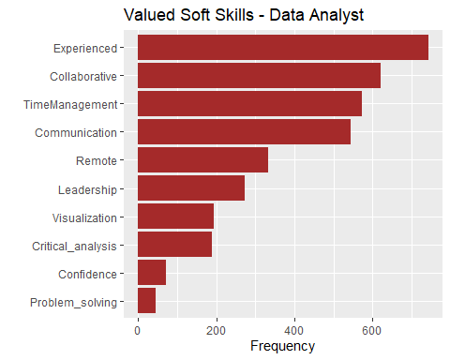
Soft Skills Data Analyst Jobs
```{r plotting the soft skills for data analyst}
ggplot(softskills_analyst,aes(x=reorder(skill, freq), y=freq)) + geom_bar(stat='identity',fill="brown") + xlab('') + ylab('Frequency') + labs(title='Valued Soft Skills - Data Analyst') + coord_flip()
```

Slide 16
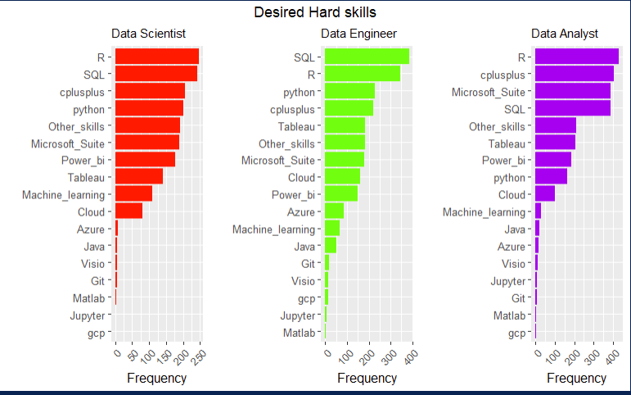
Notes:
The plots above indicate that the most 5 most valued hard skills for the following jobs are:- Data science: R, SQL, C++, Python, *Microsoft Suite*- Data engineer: SQL, R, Python, C++, Tableau- Data analyst: R, C++, Microsoft Suite, SQL, *Tableau*

Slide 17
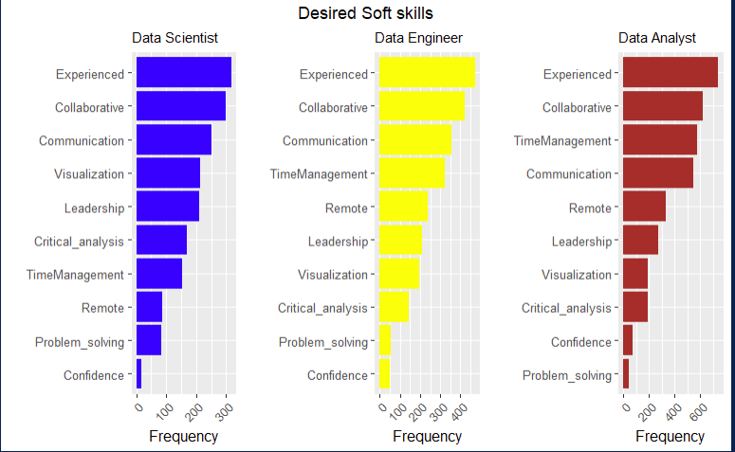
Notes:
The plots above indicate that the most 5 most valued soft skills for the following jobs are:- Data science: experience, collaboration, communication, visualization , leadership.- Data engineer: experience, collaboration, communication, time management , remote.- Data analyst: experience, collaboration, time management, communication , remote.

Slide 18
CONCLUSION
The plots above indicate that the most 5 most valued soft skills for the following jobs are:
Data science: experience, collaboration, communication, visualization , leadership.
Data engineer: experience, collaboration, communication, time management , remote.
Data analyst: experience, collaboration, time management, communication , remote.

